Slide 1
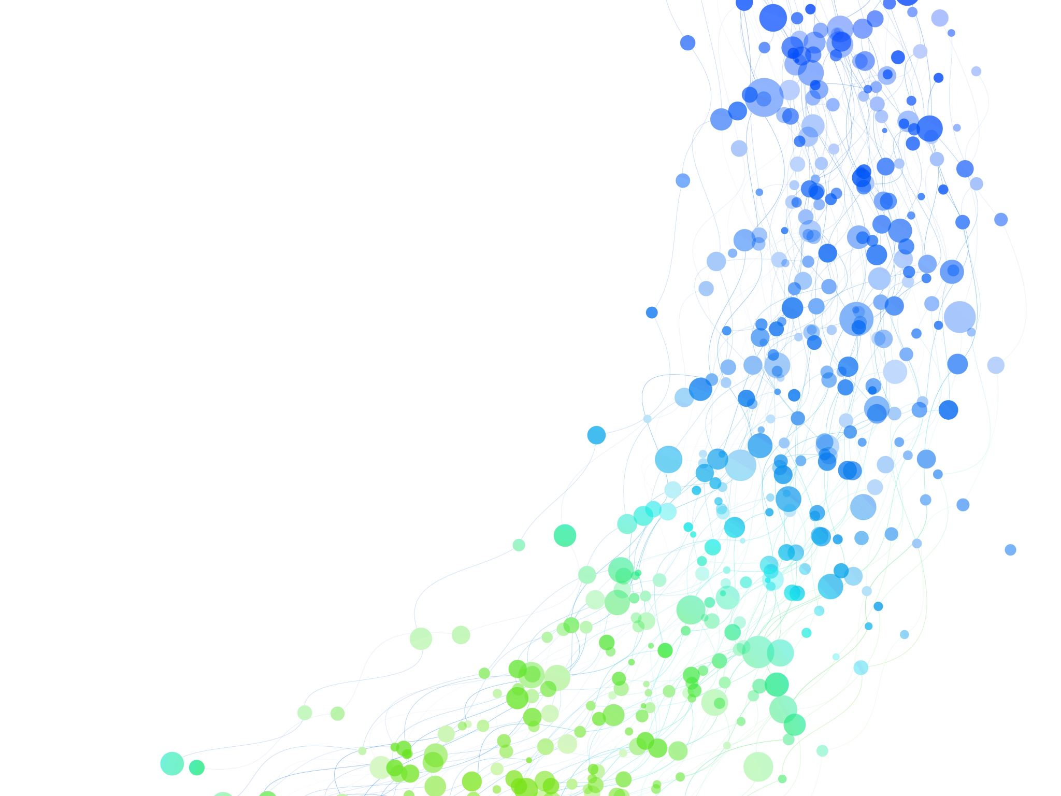

Final Project SCM 516
by Synergy Sparks
Akanksha Manohar
Meenakshi Rajeev Nair
Neha Tiwari
Niketha Venkatesh
Shriya Karthikeyan

Slide 2
Link of our Presentation:
SCM-516_Final_Project

Slide 3
Objective
To harness predictive modeling to extract meaningful insights from data using classification and regression algorithms.
Classification dataset: Naïve Bayes, Decision Tree, Random Forest, KNN, feature importance and conditional probability.
Regression dataset: linear and polynomial regression models to predict the values of a response (target) variable.
By the end, we aim to identify the most effective model and assess its generalization ability.

Slide 4
About Classification Dataset
Customer Churn Prediction Dataset:
Dataset Overview:
We will be predicting customer churn where definition of the target variable is:
Churn: 1 = Customer left,
0 = Customer stayed.
Key Features:
Demographics: Age of the customer.
Subscription Details: Subscription length, contract type (one-year, two-year, month-to-month).
Usage Behavior: Total data usage (GB), number of support calls.
Billing & Payment: Payment method, additional services subscribed.
Objective:
Use machine learning for binary classification to predict churn.
Help businesses identify at-risk customers and reduce churn.

Slide 5
Preprocessing steps:
﻿﻿Dataset Overview: Collected real-world data with multiple features for classification.
﻿﻿Handling Missing Data: Implemented imputation strategies to ensure data completeness.
Label Encoding: Converted categorical labels into numerical values.
Outlier Removal: Used boxplot analysis to detect and remove outliers.
SMOTE Analysis: Applied SMOTE to balance the dataset.
﻿﻿Data Normalization: Standardized feature values to enhance model efficiency.
﻿﻿Splitting Strategy: Divided data into training and testing sets for evaluation.
Notes:
But before applying machine learning models, it's crucial to preprocess data to ensure accuracy and reliability.
"To ensure data quality and enhance model performance, we followed several preprocessing steps:"
Handled missing data using imputation techniques to maintain completeness.
Converted categorical labels into numerical values through label encoding.
Detected and removed outliers using boxplot analysis for improved consistency.
We also applied SMOTE to balance the dataset and avoid bias in classification models.
Next, we standardized feature values through normalization to ensure efficient model training.
And lastly, we split the dataset into training and testing sets for accurate performance evaluation.
[Handover] "With these preprocessing steps in place, we have laid the foundation for effective classification.
Now, I'll hand it over to Neha, who will walk you through the next steps of our analysis. Over to you, Neha!"

Slide 6

Models
﻿Naïve Bayes
﻿Decision Trees
﻿Random Forest
KNN
Goodness of Models
﻿Confusion Matrix
﻿Accuracy
﻿Precision
Recall
F1 Score
ROC Curve
Notes:
Now that the data is pre-processed, let's move on to model training, where we apply different classification algorithms like ----------- to analyze and predict outcomes based on our customer churn dataset.
To evaluate the performance of each model, we will analyze their confusion matrices along with key metrics such as accuracy, precision, recall, and F1 score. Analyzing these metrics, we gain deeper insights into model reliability and effectiveness in real-world applications.
The confusion matrix provides a detailed breakdown of true positives, true negatives, false positives, and false negatives, helping us understand where the model makes correct predictions and where it misclassifies.
Accuracy measures overall correctness.
Precision indicates how many of the predicted positives are actually correct, making it important in scenarios where false positives need to be minimized (e.g., spam detection).
Recall measures how well the model identifies actual positives, which is crucial when missing positive cases is costly (e.g., disease detection).
F1 Score is a more holistic measure of performance, balances precision and recall.
By analyzing these metrics, we gain deeper insights into model reliability and effectiveness in real-world applications.

Slide 7
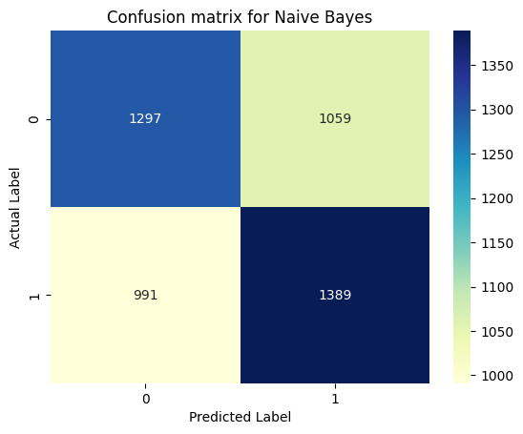
Confusion Matrix for Naïve Bayes
For Naïve Bayes:
Accuracy: 63%
Precision: 62%
Recall: 68%
F1 Score: 65%

Slide 8
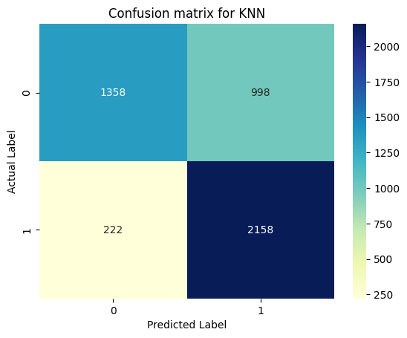
Confusion Matrix for KNN
For KNN:
Accuracy: 68%
Precision: 65%
Recall: 78%
F1 Score: 71%

Slide 9
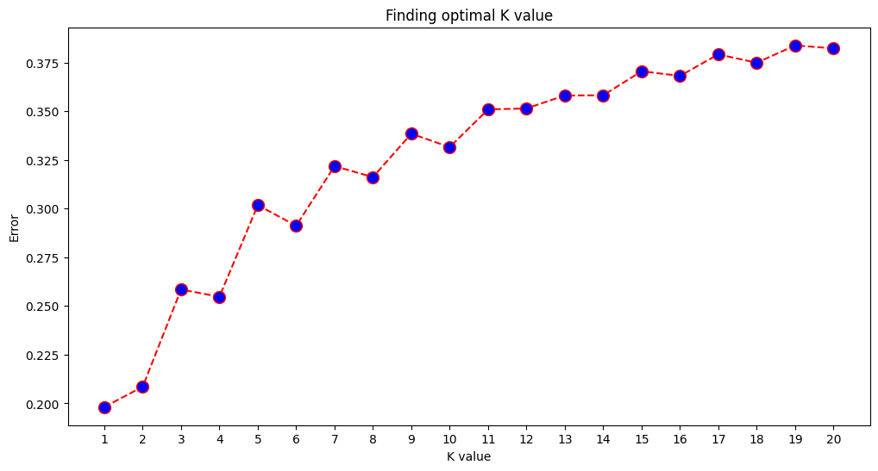
Finding the Optimal K:

Slide 10
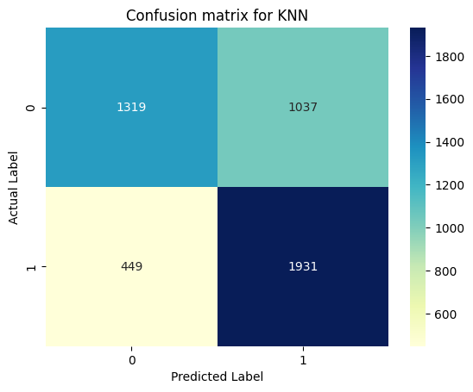
Confusion Matrix for KNN for optimal k=1
For KNN:
Accuracy: 69%
Precision: 65%
Recall: 81%
F1 Score: 72%

Slide 11
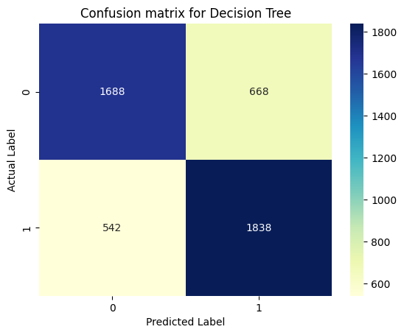
Confusion Matrix for Decision Tree
For Decision Tree:
Accuracy: 76%
Precision: 75%
Recall: 77%
F1 Score: 76%

Slide 12
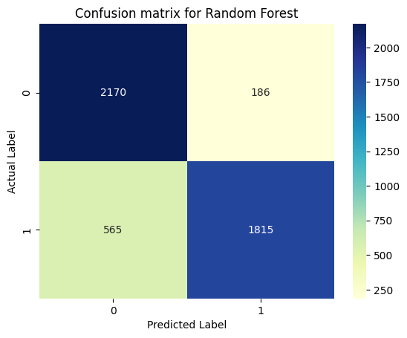
Confusion Matrix for Random Forest
For Random Forest:
Accuracy: 85%
Precision: 97%
Recall: 72%
F1 Score: 83%

Slide 13
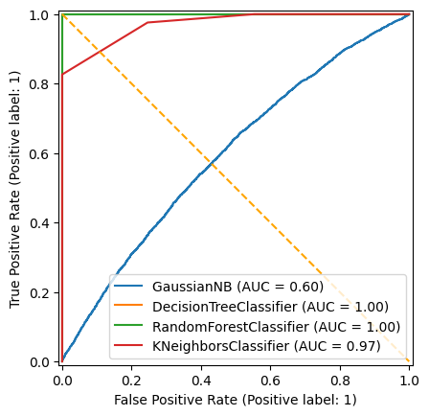
ROC Curve Analysis (for training dataset):
On TRAINING Data-
Gaussian NB : Its curve is close to the diagonal line, indicating it's barely better than random guessing. The AUC is also relatively low.
K neighbors Classifier : This model performs very well, with its curve close to the top-left corner.
Decision Tree Classifier : This model has perfect performance. However, a perfect AUC often suggests potential overfitting.
Random Forest Classifier : Similar to the Decision Tree, the same caution about potential overfitting applies.

Slide 14
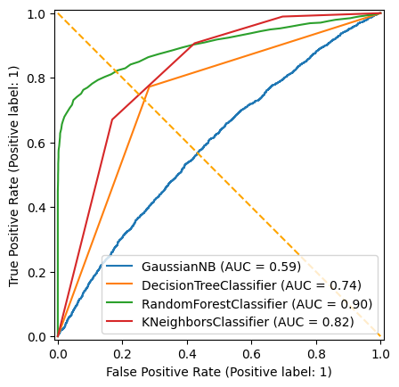
ROC Curve Analysis (for testing dataset):
On TESTING DATA-
GaussianNB (AUC = 0.59): Very poor. The curve is close to the diagonal line.
Kneighbors Classifier (AUC = 0.82): Reasonably good performance. The curve is above the diagonal line. This model also performs well on the testing data, though not as strongly as Random Forest.
Decision Tree Classifier (AUC = 0.74): Moderate performance. The curve is above the diagonal line, but not significantly.
Random Forest Classifier (AUC = 0.90): Good performance. The curve is well above the diagonal line, indicating a strong ability to distinguish between classes. This model generalizes well to the testing data and is a good choice for this classification task.

Slide 15
Performance Comparison Evaluating Model Effectiveness
﻿﻿Accuracy: Random Forest achieved the highest accuracy, outperforming other models.
﻿﻿Precision & Recall: Trade-off observed: Decision Trees had high precision but lower recall, while KNN struggled with both.
﻿﻿F1-Score: Random Forest maintained the best balance.
﻿﻿Class Imbalance: Some models were impacted by imbalanced data, affecting recall and precision.
Overall :
Random Forest demonstrated the best overall performance across all metrics.

Slide 16
Classification report of Random Forest
 | Precision | Recall | F1- score | support
Class 0 | 0.79 | 0.92 | 0.85 | 2356
Class 1 | 0.91 | 0.76 | 0.83 | 2380
Accuracy |  |  | 0.84 | 4736
Macro avg | 0.85 | 0.84 | 0.84 | 4736
Weighted avg | 0.85 | 0.84 | 0.84 | 4736
Conclusion: The model has an overall accuracy of 84% (0.84).
This means it correctly predicted the class labels for 84% of the samples in the test set.

Slide 17

Let's see how well our model performs on unseen data?

Slide 18
New dataset:
 | Customer ID | Age | Subscription Length (months) | Monthly Bill ($) | Total Usage (GB) | Support Calls | Contract Type | Payment Method | Has Additional Services
1 | 10001 | 43.296 | 33.66 | 107.8 | 230.95 | 1 | Month-to-Month | Debit Card | 1
2 | 10002 | 55.704 | 48.45 | 144.6 | 398.05 | 9 | One Year | Credit Card | 1
3 | 10003 | 35.928 | 27.08 | 71.65 | 131.65 | 1 | Month-to-Month | PayPal | 0

Slide 19
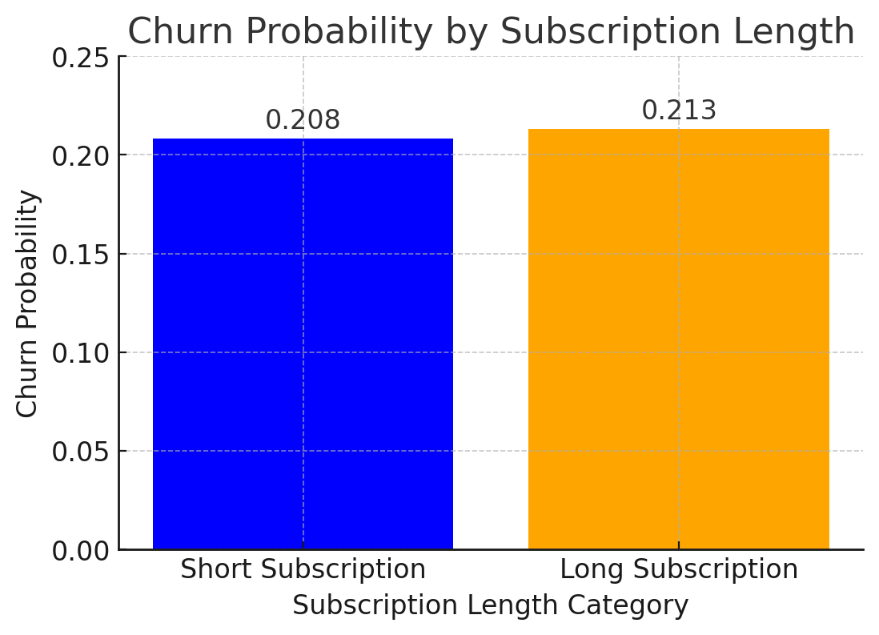
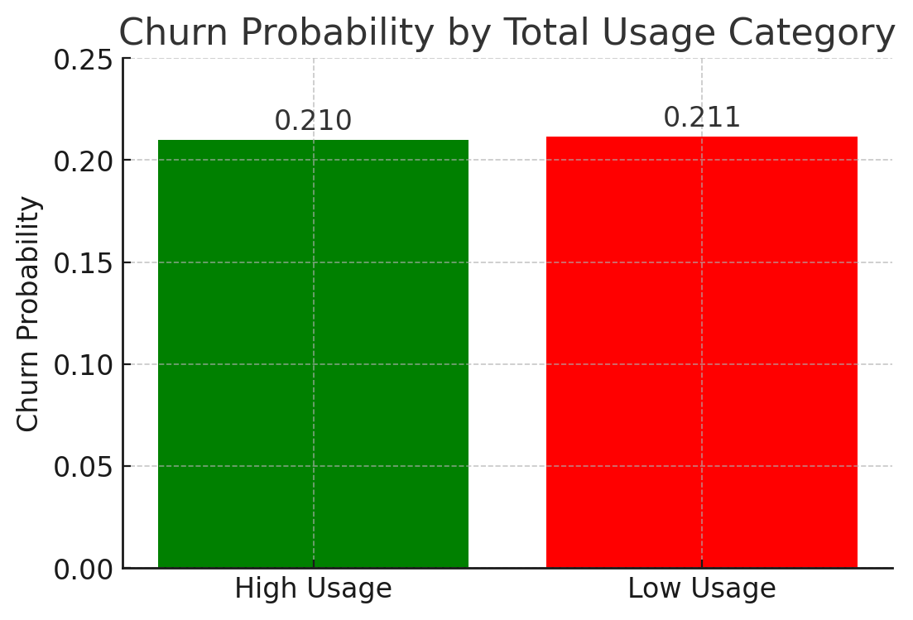
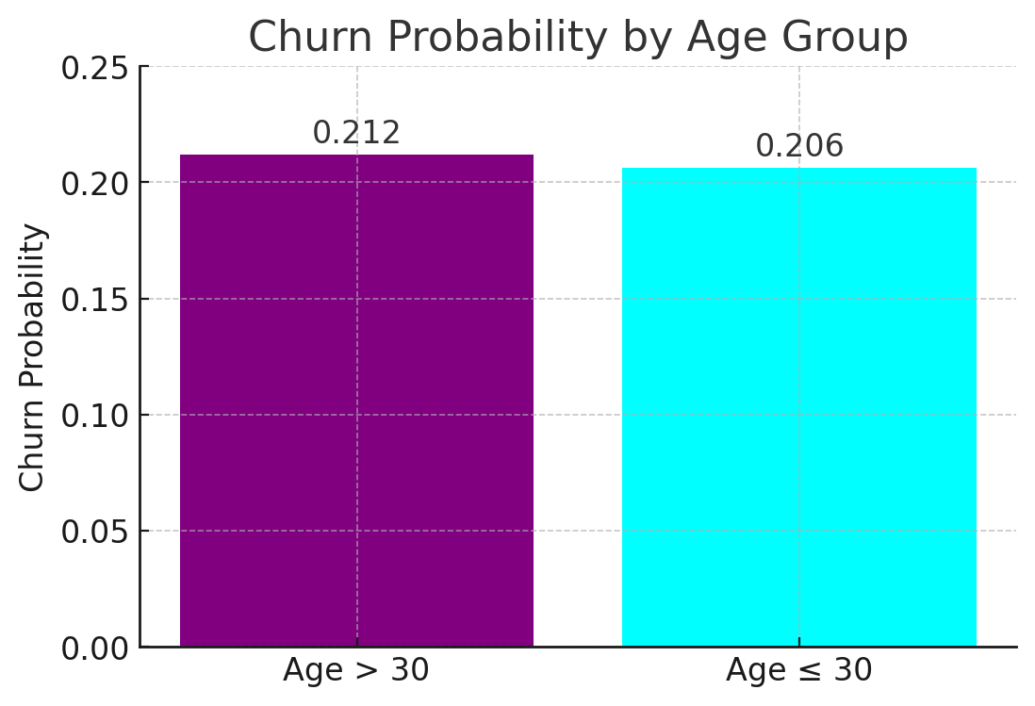
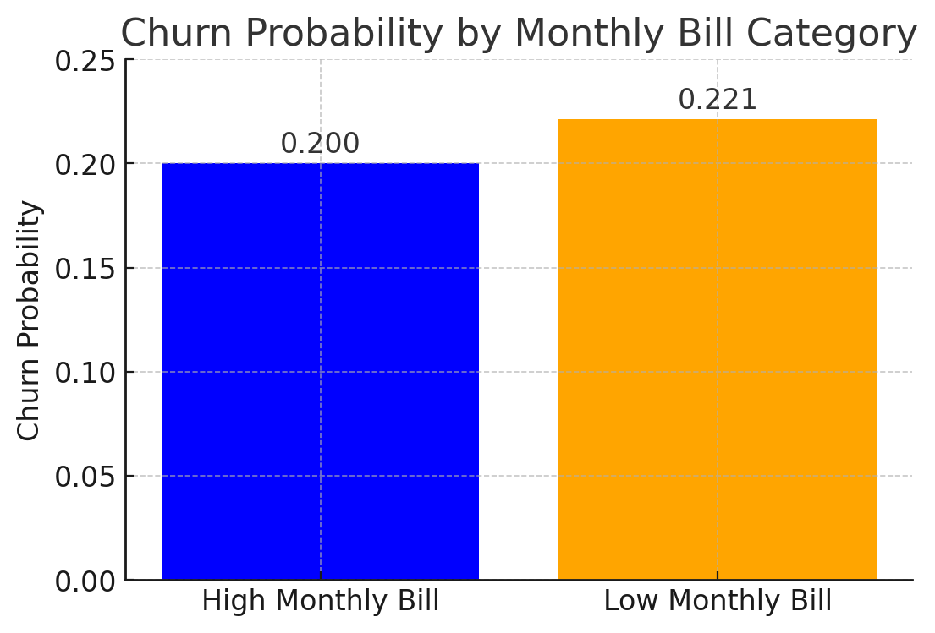
Feature Importance using Naïve Bayes

Slide 20
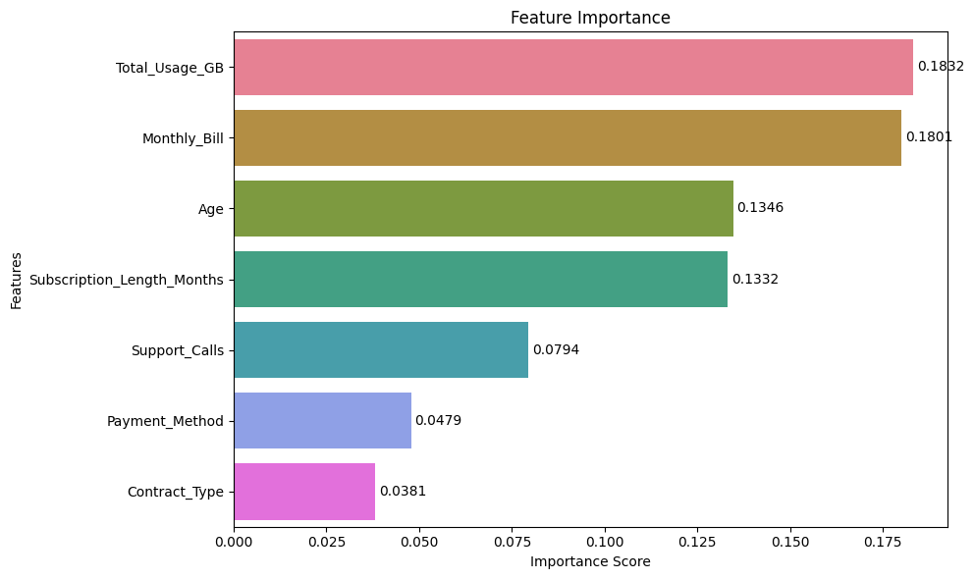
Importance of Feature (determined using Random Forest):

Slide 21
Which model performed best?
Random Forest emerged as the top-performing model due to its ensemble learning approach. Unlike a single decision tree, it aggregates predictions from multiple trees, significantly improving accuracy.
One of its key strengths is robustness—Random Forest is less sensitive to noisy data and missing values compared to other classifiers.
It also provides feature importance rankings, helping us understand which variables influence predictions the most.
Moreover, it strikes an excellent balance between bias and variance, avoiding overfitting while maintaining high predictive power.
Our results confirm that Random Forest consistently outperformed other models across all key performance metrics.

Slide 22
New dataset with churn values:
 | Customer ID | Age | Subscription Length (months) | Monthly Bill ($) | Total Usage (GB) | Support Calls | Contract Type | Payment Method | Has Additional Services
1 | 10001 | 43.296 | 33.66 | 107.8 | 230.95 | 1 | Month-to-Month | Debit Card | 1
2 | 10002 | 55.704 | 48.45 | 144.6 | 398.05 | 9 | One Year | Credit Card | 1
3 | 10003 | 35.928 | 27.08 | 71.65 | 131.65 | 1 | Month-to-Month | PayPal | 0
No Churn | Churn = 1
62% | 38%
72% | 28%
61% | 39%

Slide 23
Are there any signs of overfitting?
While machine learning models offer powerful predictive capabilities, they come with challenges and limitations.
Data quality —no model can outperform the quality of its input data.
Overfitting – where a model performs exceptionally well on training data but struggles on new data.
Computational cost –models like Random Forest require significant processing power, making them less feasible for real-time applications.
Hyperparameter tuning – finding the right balance between bias and variance.
Interpretability – making it difficult to explain predictions, especially in fields requiring transparency, such as healthcare and finance.

Slide 24
Key Insights from Conditional Probability Analysis of Customer Churn:
Churn Risk Factors:
Customers with high monthly bills ($90+), heavy data usage (300GB+),
or multiple support calls (5+ calls) → (~20%)
Month-to-Month contract customers (especially heavy users) are at higher churn risk (33%)
Customers with long-term contracts (2+ years, 36+ months) have slightly lower churn (~21%)
Older customers (60+) with low usage (<100GB) have the lowest churn probability (~18%)

Slide 25

Regression Analysis:

Slide 26
About Regression Dataset
House Rent Prediction Dataset:2
Dataset Overview:
Target variable is rent.
Key Features:
Includes numerical attributes like BHK, size, bathroom.
Objective:
Apply Multiple Linear and Polynomial Regression to predict rental prices based on relevant features.
Aims to predict rent prices based on other independent variables.
Analyze the impact of different property attributes on rent to improve decision-making for renters and property owners.
Includes categorical attributes like floor level, city, furnishing status and tenant preferences.

Slide 27
Independent variables:
 | BHK | Size | Furnishing status | Bathroom | Floor number | Carpet Area | Super Area | Chennai | Delhi | Hyderabad | Kolkata | Mumbai
0 | 2 | 1100 | 0 | 2 | 0 | False | True | False | False | False | True | False
1 | 2 | 800 | 1 | 1 | 1 | False | True | False | False | False | True | False
2 | 2 | 1000 | 1 | 1 | 1 | False | True | False | False | False | True | False
3 | 2 | 800 | 0 | 1 | 1 | False | True | False | False | False | True | False
4 | 2 | 850 | 0 | 1 | 1 | True | False | False | False | False | True | False

Slide 28
Preprocessing steps:
﻿﻿Dataset Overview: Real-world housing rental data with features like rent, size, location, and furnishing status.
﻿﻿Handling Missing Data: Used imputation techniques to ensure data completeness.﻿﻿
Categorical to Numerical Conversion: Transformed categorical features for model compatibility.
One-Hot Encoding: Applied one-hot Encoding to multi-category variables to retain information.
Boolean Conversion: Converted Boolean columns to integers (0/1).
﻿﻿Splitting Strategy: Split data into training and testing sets for evaluation.

Slide 29
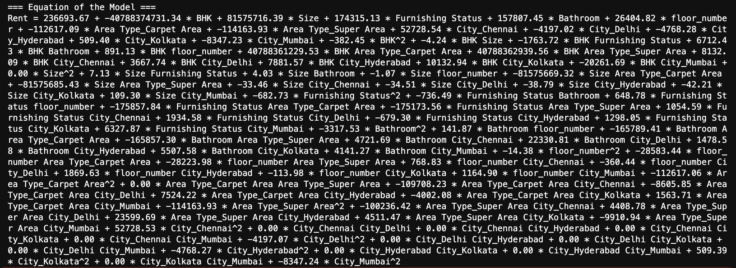
Equation of the Model:

Slide 30

Interpretation of the Regression Equation
Rent is influenced by multiple factors, including:
Size: Larger properties generally have higher rents.
BHK: Unexpected large negative impact suggests possible data issues.
Furnishing Status: Furnished properties command higher rents.
Bathrooms: More bathrooms increase rent.
Floor Number: Higher floors slightly increase rent.

Slide 31
Regression model methods:
Multiple Linear Regression
Polynomial Regression

Slide 32

Interpretation of R2 and adjusted R2 (using Linear & Polynomial Regression):
For Polynomial Regression
(degree=2):
R2: 0.8137733813128744
Adjusted R2: 0.7942618613107308
For Multiple Linear Regression:
R2: 0.5228843329265807
Adjusted R2: 0.5167739935403682

Slide 33
Interpretation of R2 & R2 adjusted values:
Multiple Linear Regression:
R2 = 0.52→ The model explains 52.29% of the variance in rent prices can be explained by the independent features.
Adjusted R2 → After accounting for the number of predictors, the model still explains 51.7% of the variance, confirming that adding more features did not drastically improve the fit.
Polynomial Regression:
R2 = 0.81 → The model explains 81.38% of the variance in rent prices can be explained bu the independent variable , which is significantly higher than the multiple linear regression model.
Adjusted R² = 0.51 →After adjusting for additional predictors, the model still explains 79.4% of the variance.
INTERPRETATION:
Polynomial regression outperforms multiple linear regression in explaining the data, indicating that a nonlinear model is more suitable for our dataset.

Slide 34
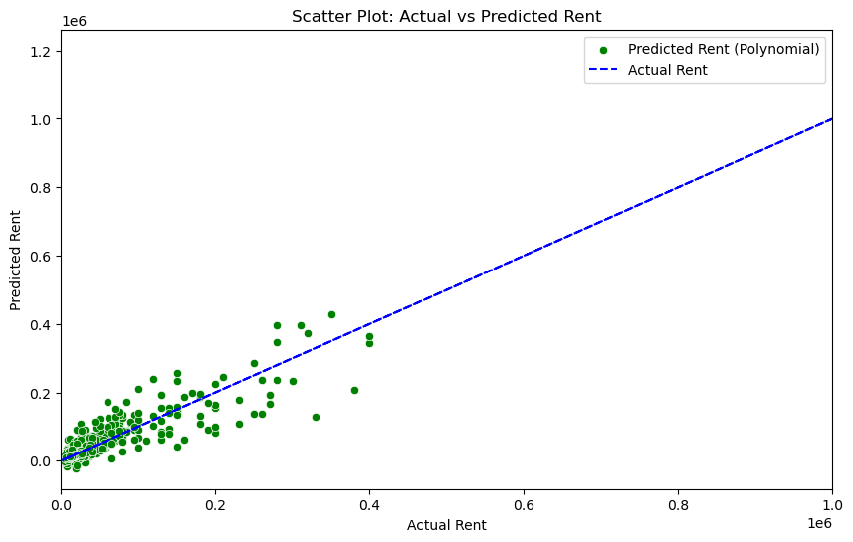
Actual vs Predicted Rent:

Slide 35
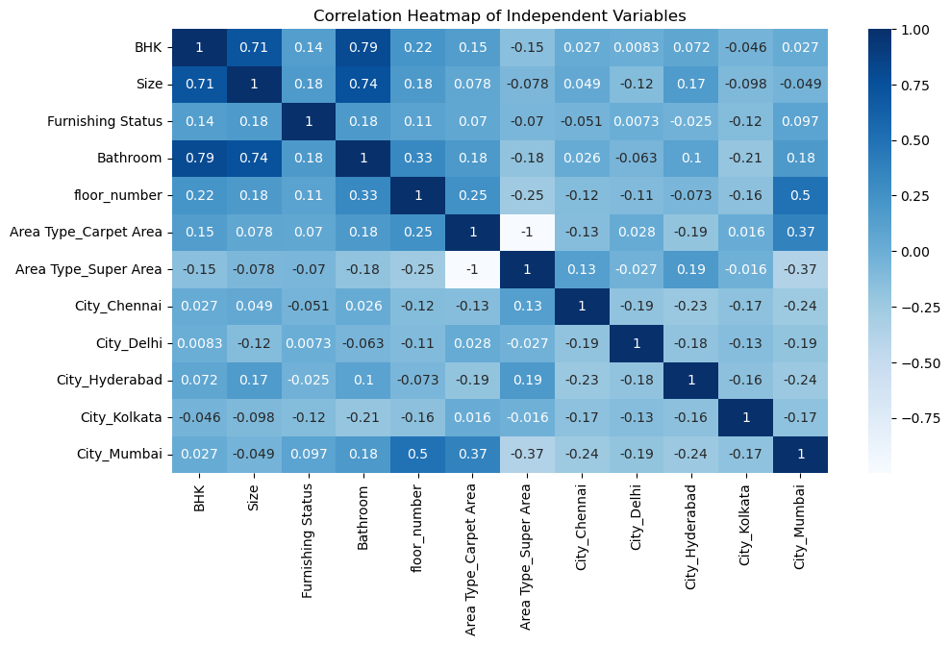
Correlation between Input variables:

Slide 36
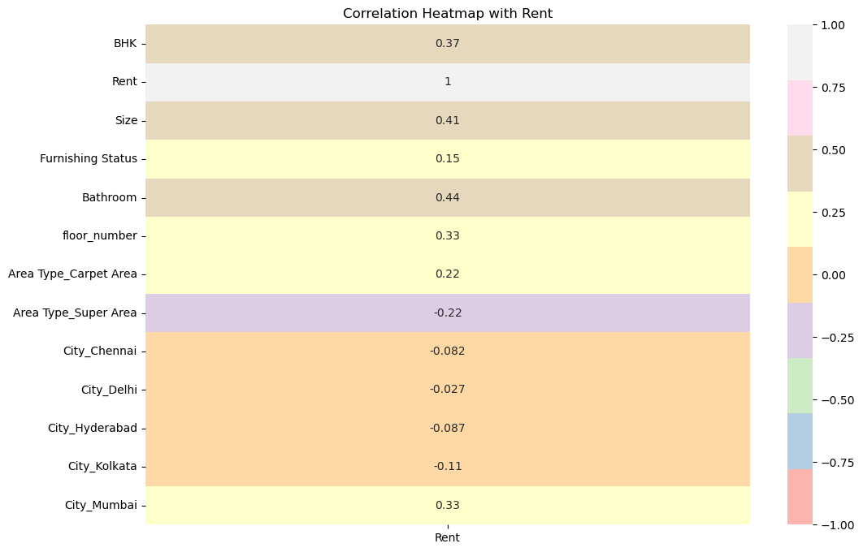
Correlation between Input & Output variable:

Slide 37
Visualization

Slide 38
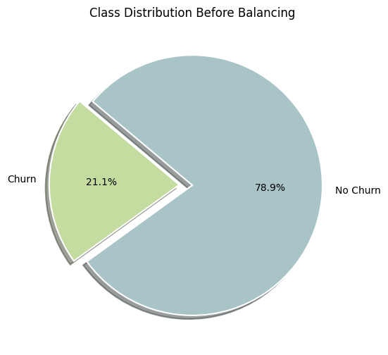
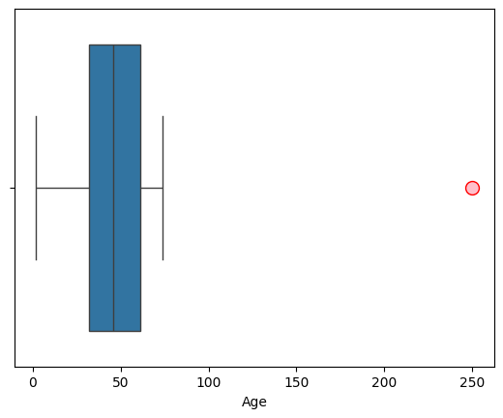
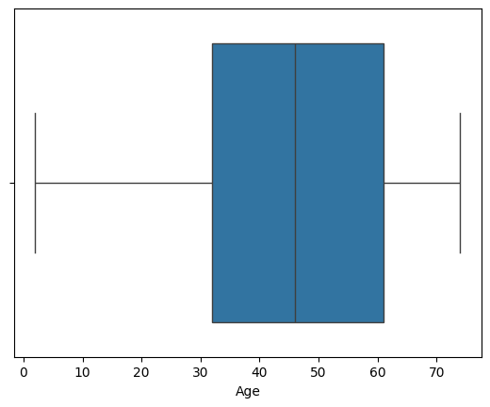
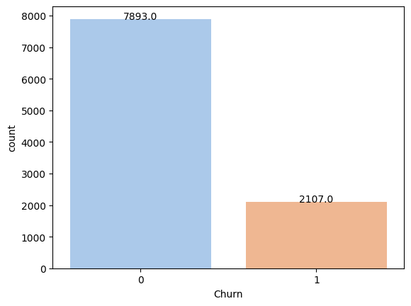
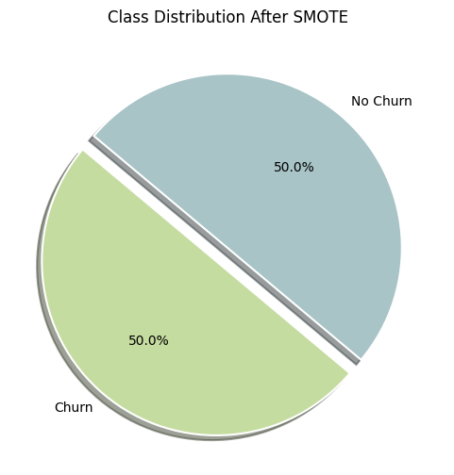
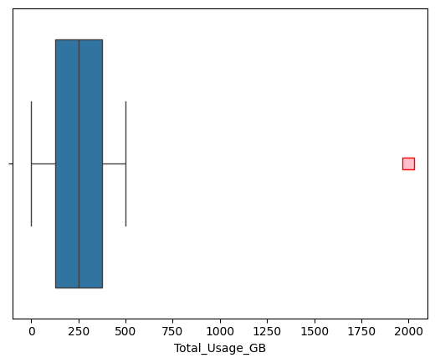
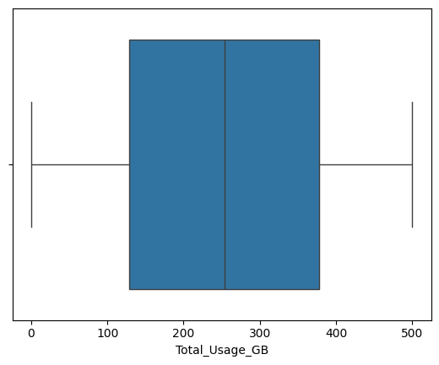
Visualizations for Binary Classification Analysis:
Class Distribution Before Balancing
Outliers detected and removed for “Age” column
Imbalanced data
Class Distribution After SMOTE
Outliers detected and removed for “Monthly Bill” column

Slide 39
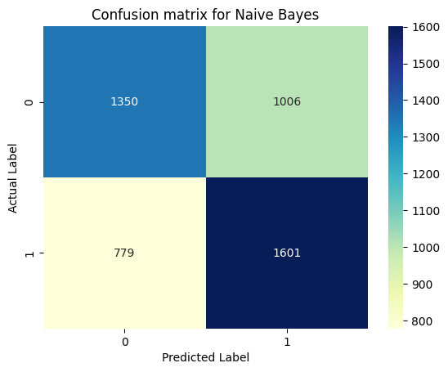
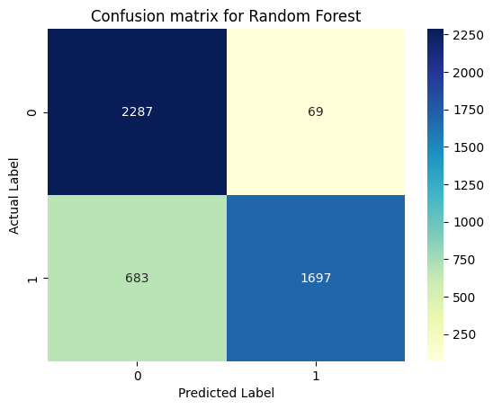
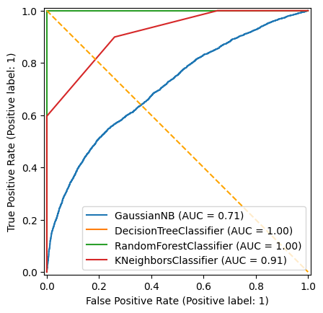
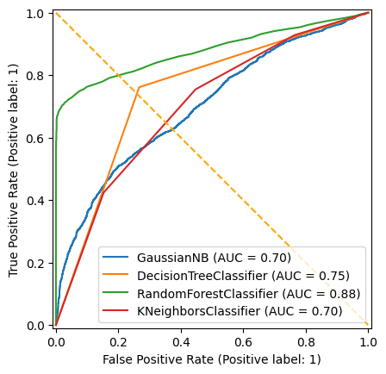

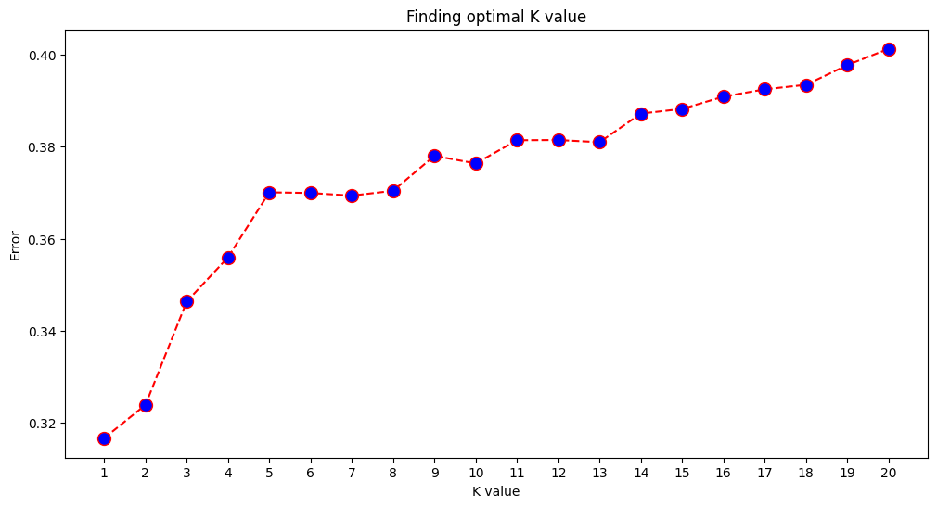
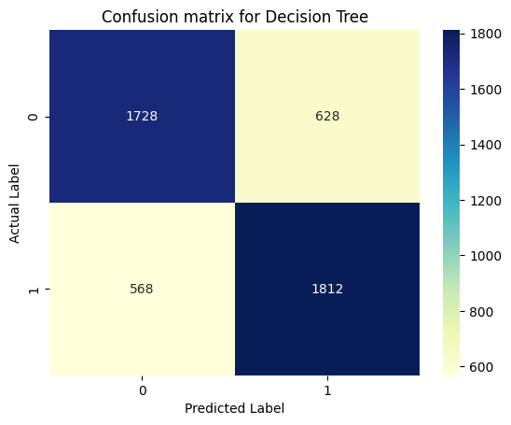
Visualizations for Binary Classification Analysis:
confusion matrix for Naive Bayes
confusion matrix for Random Forest
Features importance using Random Forest
ROC Curve for Training dataset
Finding best value of K in KNN
confusion matrix for Decision Tree
confusion matrix for KNN
ROC Curve for Testing dataset

Slide 40
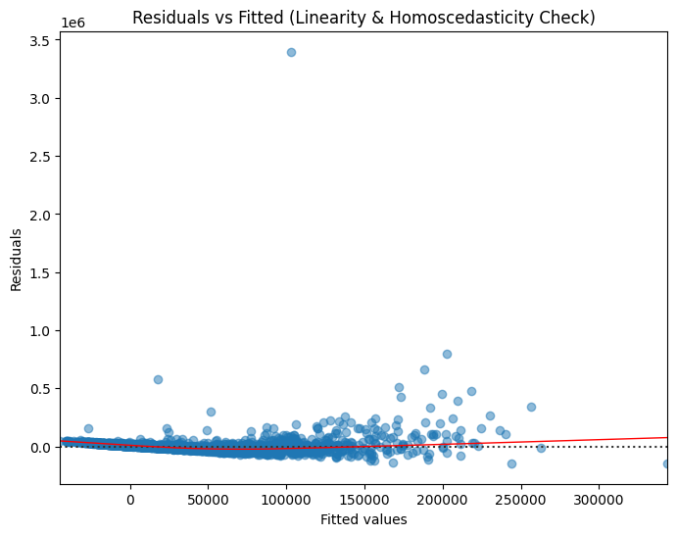
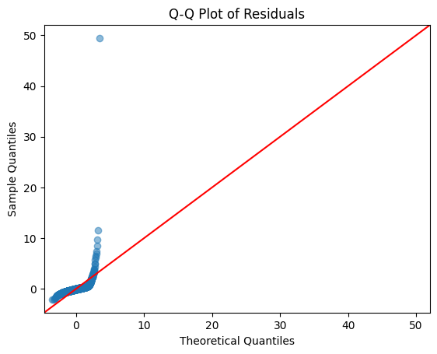
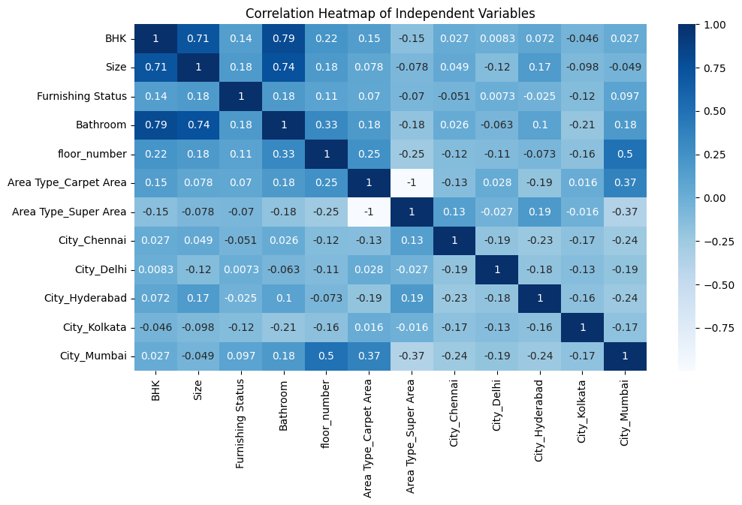
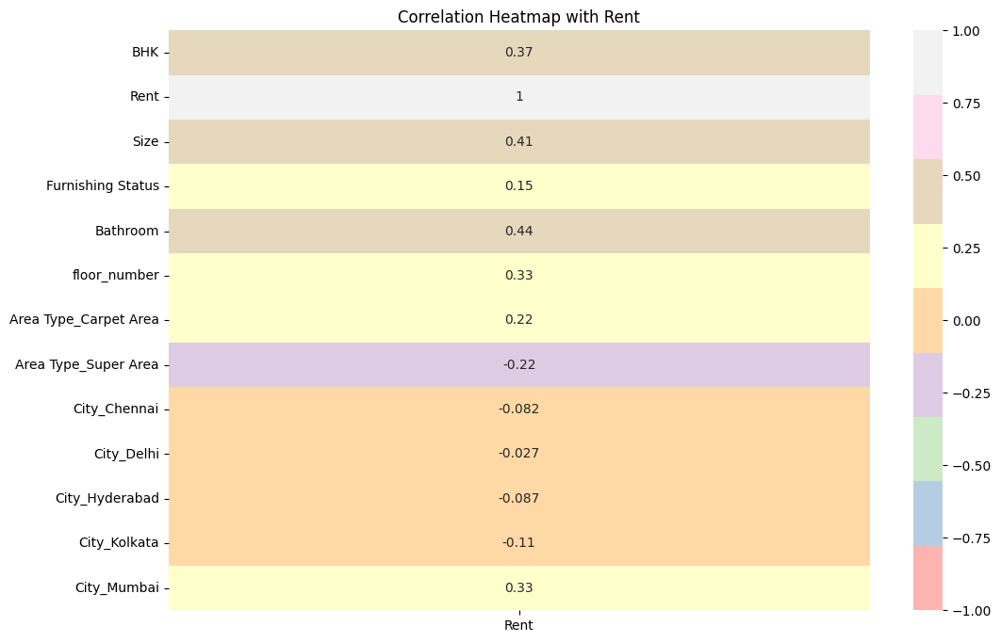
Visualizations for Regression Analysis:
Residuals vs Fitted (Homoscedasticity)
Q-Q Plot of Residuals
Correlation Heatmap of Independent Variables
Correlation Heatmap with Rent
Scatter Plot: Actual vs Predicted Rent

Slide 41
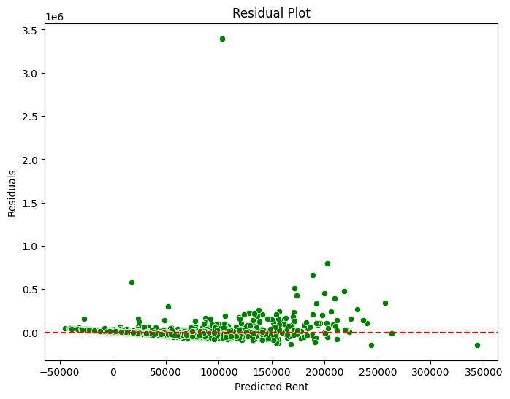
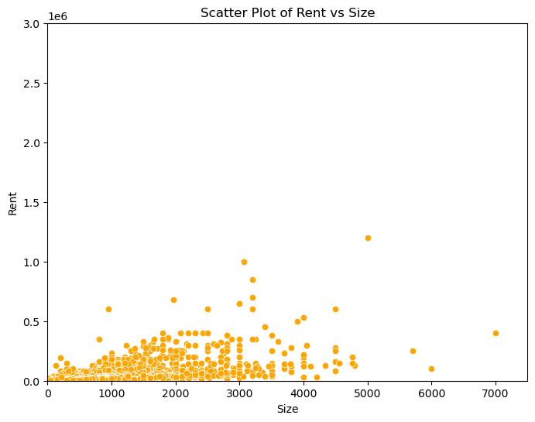
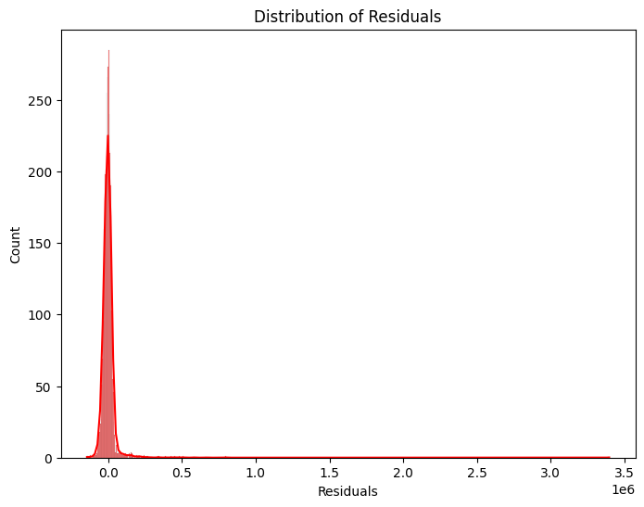
Visualizations for Regression Analysis:
Residual Plot
Scatter Plot of Rent vs Size
Distribution of Residuals

Slide 42

Thank you!

